Slide 1
From Gust To Tempest: Scaling Storm
PRESENTED BY Bobby Evans

Slide 2
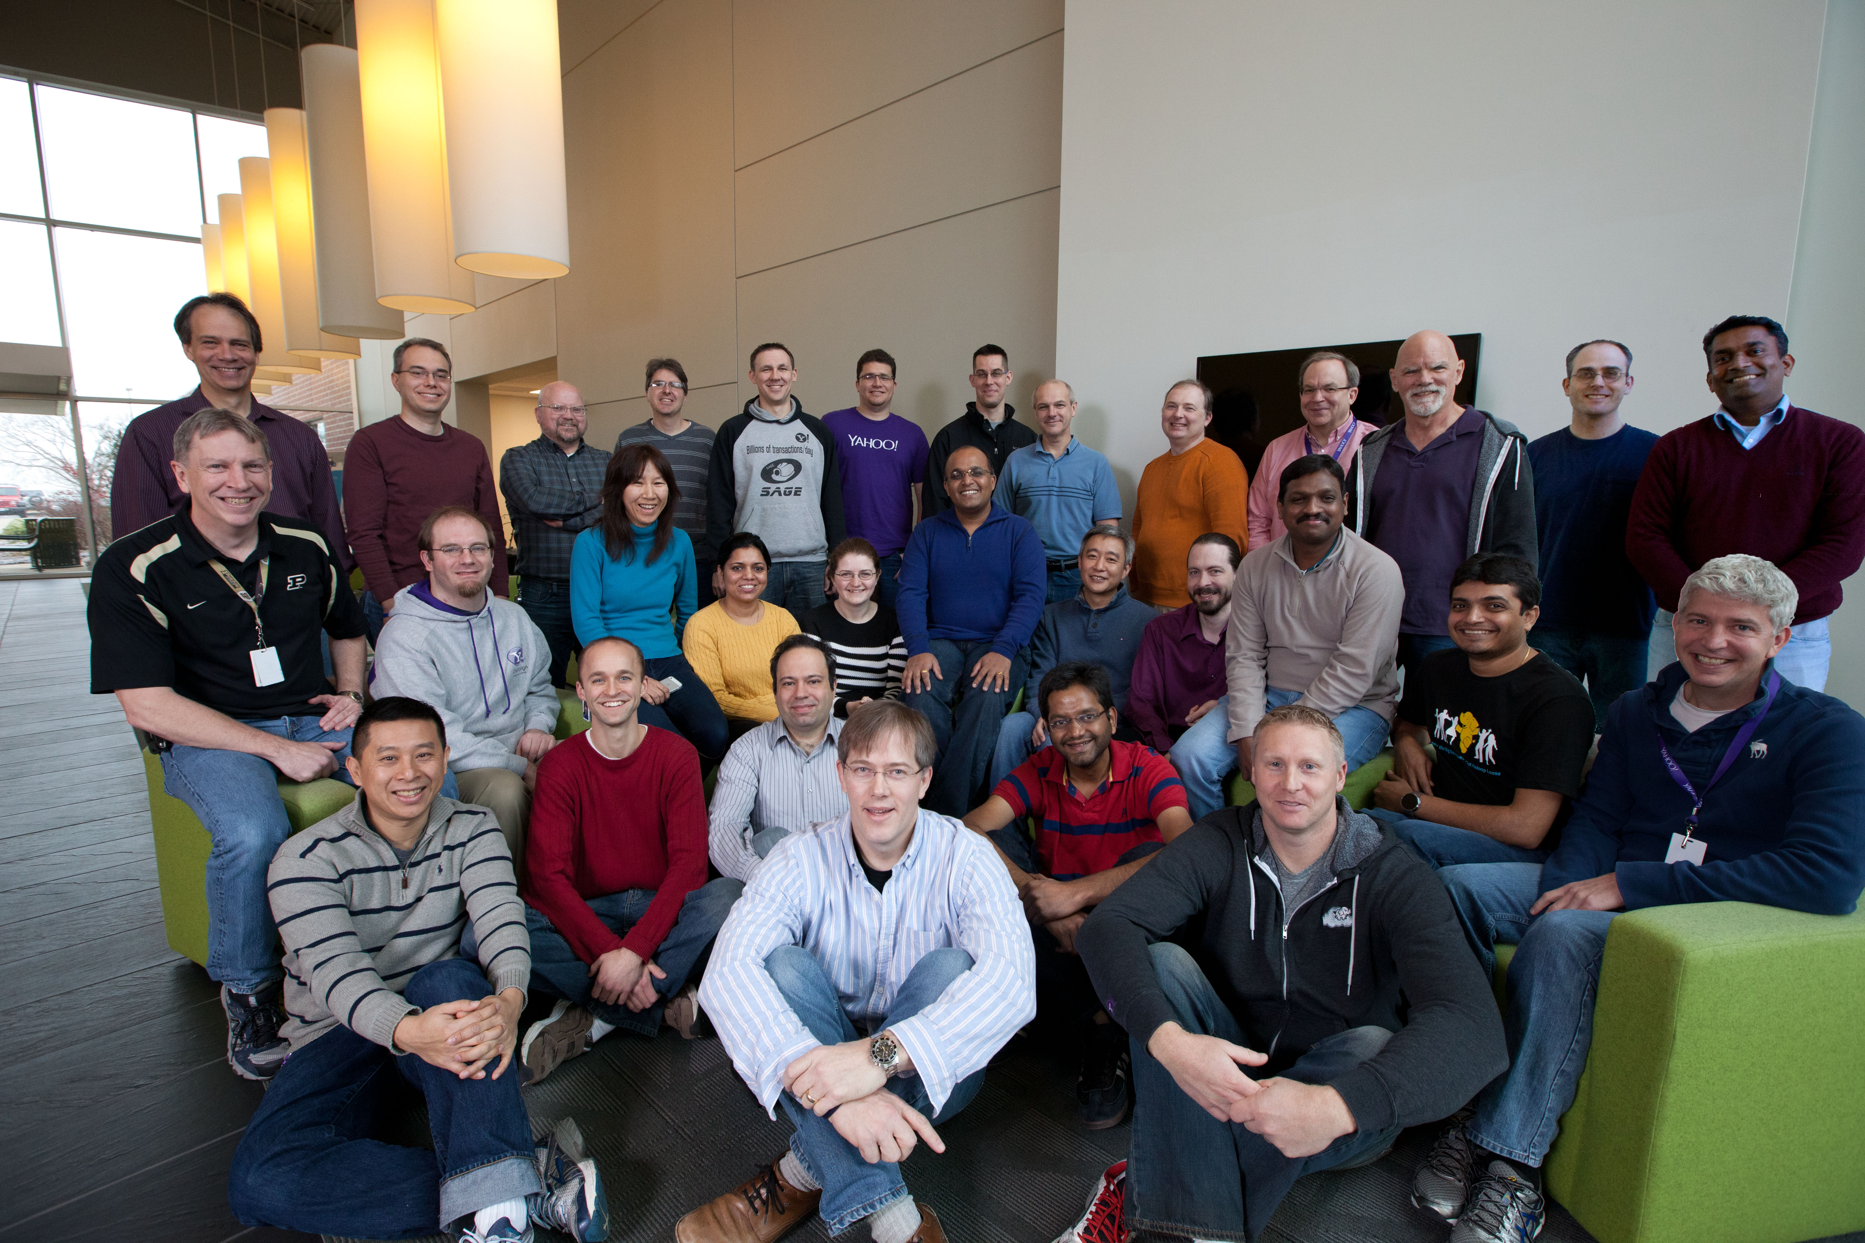
Hi I’m Bobby Evans bobby@apache.org
Low Latency Data Processing Architect @ Yahoo
Apache Storm
Apache Spark
Apache Kafka
Committer and PMC member for
Apache Storm
Apache Hadoop
Apache Spark
Apache TEZ

Slide 3

Agenda
Apache Storm Architecture
What Was Done Already
Current/Future Work
background: https://www.flickr.com/photos/gsfc/15072362777

Slide 4

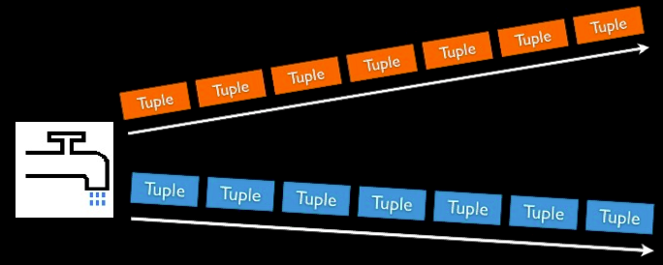
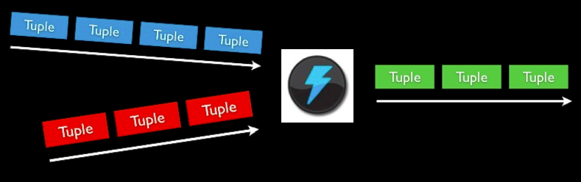
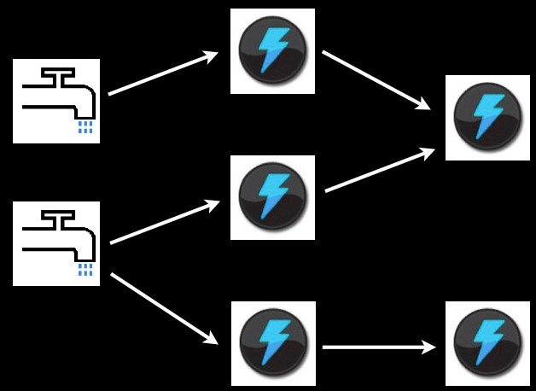
Storm Concepts
Streams
Unbounded sequence of tuples
Spout
Source of Stream
E.g. Read from Twitter streaming API
Bolts
Processes input streams and produces new streams
E.g. Functions, Filters, Aggregation, Joins
Topologies
Network of spouts and bolts

Slide 5
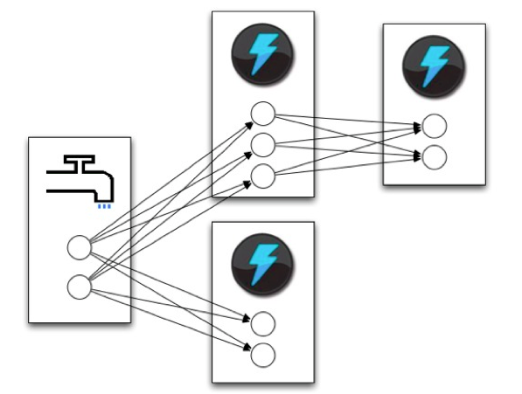
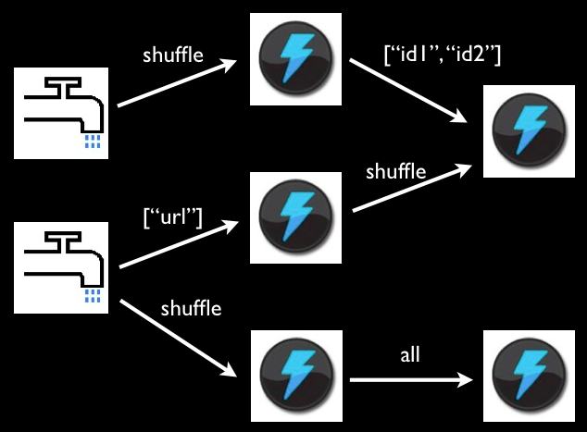
Routing of tuples
Shuffle grouping: pick a random task (but with load balancing)
Fields grouping: consistent hashing on a subset of tuple fields
All grouping: send to all tasks
Global grouping: pick task with lowest id
Shuffle or Local grouping: If there is a local bolt (in the same worker process) use it otherwise use shuffle
Partial Key grouping: Fields grouping but with 2 choices for load balancing.

Slide 6
Storm Architecture
Worker
Supervisor
Worker
Zookeeper
Supervisor
Nimbus
Zookeeper
Supervisor
Worker
Zookeeper
Supervisor
Worker
Master Node
Cluster Coordination
Launches workers
Worker processes

Slide 7
Worker
Task
(Spout A-1)
Task
(Spout A-5)
Task
(Spout A-9)
Routing
Task
(Bolt B-3)
Other Workers
Task
(Acker)

Slide 8
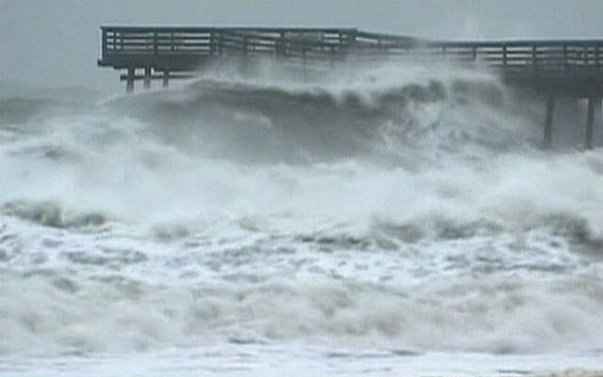
Current State what was done already
background: https://www.flickr.com/photos/maf04/14392794749

Slide 9

Largest Topology Growth at Yahoo
background: https://www.flickr.com/photos/68942208@N02/16242761551

Slide 10

Cluster Growth at Yahoo
background: http://bit.ly/1KypnCN

Slide 11

In the Beginning…
Mid 2011:
Storm is released as open source
Early 2012:
Yahoo evaluation begins
https://github.com/yahoo/storm-perf-test
Mid 2012:
Purpose built clusters 10+ nodes
Early 2013:
60-node cluster, largest topology 40 workers, 100 executors
ZooKeeper config -Djute.maxbuffer=4194304
May 2013:
Netty messaging layer
http://yahooeng.tumblr.com/post/64758709722/making-storm-fly-with-netty
Oct 2013:
ZooKeeper heartbeat timeout checks
background: https://www.flickr.com/photos/gedas/3618792161

Slide 12
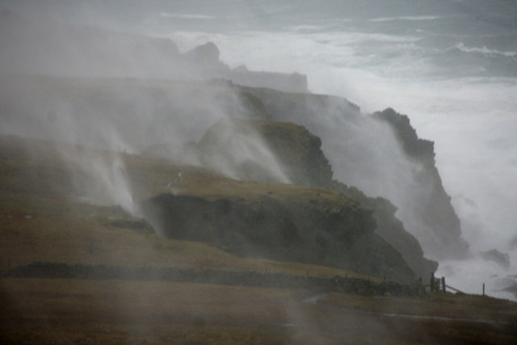
So Far…
Late 2013:
ZooKeeper config -Dzookeeper.forceSync=no
Storm enters Apache Incubator
Early 2014:
250-node cluster, largest topology 400 workers, 3,000 executors
June 2014:
STORM-376 – Compress ZooKeeper data
STORM-375 – Check for changes before reading data from ZooKeeper
Sep 2014
Storm becomes an Apache Top Level Project
Early 2015:
STORM-632 Better grouping for data skew
STORM-634 Thrift serialization for ZooKeeper data.
300-node cluster (Tested 400 nodes, 1,200 theoretical maximum)
Largest topology 1,500 workers, 4,000 executors
background: http://s0.geograph.org.uk/geophotos/02/27/03/2270317_7653a833.jpg

Slide 13

We still have a ways to go
We want to get to a 4,000-node Storm cluster.
background: https://www.flickr.com/photos/68397968@N07/14600216228

Slide 14

Future and Current Work how we are going to get to 4,000
background: https://www.flickr.com/photos/12567713@N00/2859921414

Slide 15
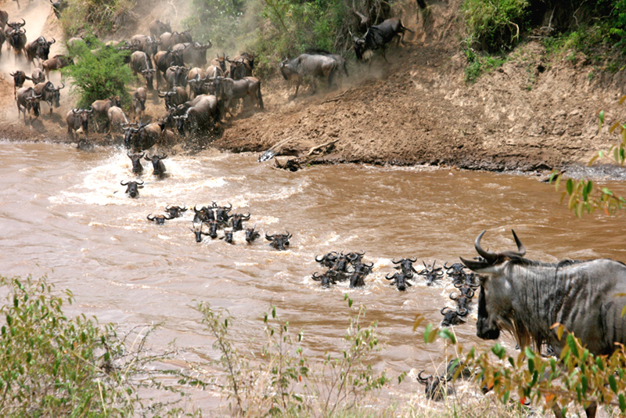

Why Can’t Storm Scale? It’s all about the data.
State Storage (ZooKeeper):
Limited to disk write speed (80MB/sec typically)
Scheduling
O(num_execs * resched_rate)
Supervisor
O(num_supervisors * hb_rate)
Topology Metrics (worst case)
O(num_execs * num_comps * num_streams * hb_rate)
On one 240-node Yahoo Storm cluster, ZK writes 16 MB/sec, about 99.2% of that is worker heartbeats
Theoretical Limit:
80 MB/sec / 16 MB/sec * 240 nodes = 1,200 nodes
background: http://cnx.org/resources/8ab472b9b2bc2e90bb15a2a7b2182ca45a883e0f/Figure_45_07_02.jpg

Slide 16

Pacemaker heartbeat server
Simple Secure In-Memory Store for Worker Heartbeats.
Removes Disk Limitation
Writes Scale Linearly
(but nimbus still needs to read it all, ideally in 10 sec or less)
240 node cluster’s complete HB state is 48MB, Gigabit is about 125 MB/s
10 s / (48 MB / 125 MB/s) * 240 nodes = 6,250 nodes
Highly-connected topologies dominate data volume.
10 GigE helps

Slide 17

Why Can’t Storm Scale? It’s all about the data.
All raw data serialized, transferred to UI, de-serialized and aggregated per page load
Our largest topology uses about 400 MB in memory
Aggregate stats for UI/REST in Nimbus
10+ min page load to 7 seconds
DDOS on Nimbus for jar download
Distributed Cache/Blob Store (STORM-411)
Pluggable backend with HDFS support
background: https://www.flickr.com/photos/oregondot/15799498927

Slide 18

Why Can’t Storm Scale? It’s all about the data.
Storm round-robin scheduling
R-1/R % of traffic will be off rack where R is the number of racks
N-1/N % of traffic will be off node where N is the number of nodes
Does not know when resources are full (i.e. network)
Resource & Network Topography Aware Scheduling
One slow node slows the entire topology.
Load Aware Routing (STORM-162)
Intelligent network aware routing

Slide 19

How does this compare to…
Heron (Twitter) and Apex (DataTorrent)?
Code not released yet (June 9, 2015 at 6 am Pacific)
So I have not seen it
And we are not done yet either
So, it is hard to tell
Google Cloud Dataflow?
Open Source API, not implementation
I have not tested it for scale
Great stream processing concepts
background: http://www.publicdomainpictures.net/view-image.php?image=38889&picture=heron-2&large=1

Slide 20

Questions?
bobby@apache.org
https://www.flickr.com/photos/51029297@N00/5275403364

